Slide 1
Universal Heat Pump Defrost Control 47D01U-843
March 2020

Slide 2
Market and Product Overview
47D01U-843 Universal Defrost Control

Slide 3
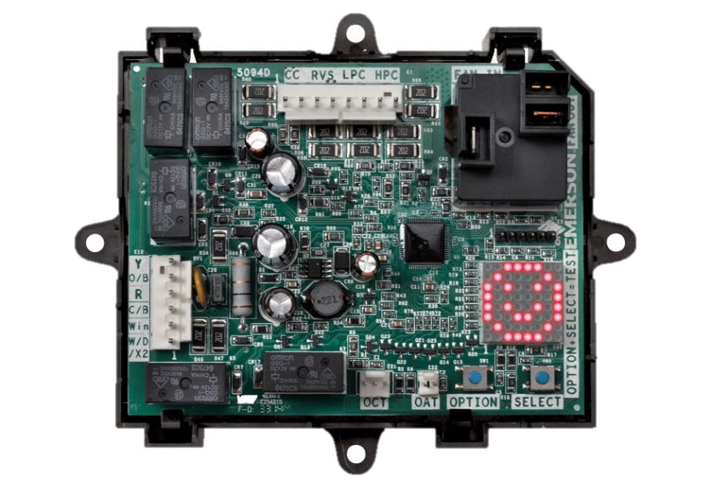
Introduction
The 47D01U-843 Universal Heat Pump Defrost Control is the first microprocessor-based universal replacement defrost controller intended for single stage heat pump systems.
Supports two defrost modes:
Demand Defrost: initiates when a set difference between the outside coil and air temperature is reached
Time/Temp Defrost: based on a field set temperature and run time
Supports both O/B Reversing Valve options (Heating/Cooling)

Slide 4
Demand Defrost
The White-Rodgers Defrost Timer Control combines an electronic timer with temperature sensors to identify when an outdoor coil is frozen or not providing heat efficiently. This sends the unit into defrost mode to remove frozen water that restricts airflow through the outdoor coil.
Time Defrost
Demand Defrost
A Timer initiates the Defrost mode every 30 to 120 minutes. If / when the Coil Temperature Sensor is warm enough, it returns to the Heat mode.
An Outdoor Temperature Sensor and Coil Temperature Sensor monitors the system. When it determines there is frost build up, it will initiate the Defrost mode.
Defrost every ½-2 hours
Defrost only when needed

Slide 5
Eliminate Ice Build Up
When the outdoor coil is colder than the air during heating mode, it causes the air going through the coil to give up its heat.
Moisture in the air condenses on the surface of the coil and freezes over time, restricting airflow through the coil
As the moisture freezes to ice, the heat-pump becomes more inefficient and cannot properly absorb heat to be released into the conditioned space
In order to melt the ice and return to proper airflow, the unit goes into “Defrost” mode by running hot refrigerant through the coil
The frequency of ice build-up depends on outside air temperature and humidity

Slide 6
Top Line Features and Benefits
This award-winning heat pump control replaces hundreds of OEM defrost controls while offering premium features that benefit both the contractor and the end-user.
Increase Efficiency
Feature | Function
Demand Defrost Option | Reduces energy usage compared to Time/Temp cycles
AUX Heat Lockout | Limits use above set temperature (No accessory kit needed)*
Low Temp Compressor Lockout | Low Temp Compressor Lockout Limits heat pump usage at inefficient temperatures
Easy to Install / Service
Feature | Function
Versatile Mounting Tray | One, universal part of all systems
Pre-Configured, Adjustable Settings | Select from OEM pre-sets or customize
Test Mode | Verify operation at any temperature
8x8 Matrix LED Display | Immediate, easy visualization of system status and faults
O/B Reversing Valve | Supports energizing in both heating and cooling
* Value add for CA Title 24, by locking out AUX heat until below 40°
US Patents 9,037,303 • 9,412,328
9,830,887 • 9,064,345

Slide 7
47D01U-843 Competitive Comparison
Feature | White-Rodgers 47D01U-843 | Brand X DB7110U
Board Cross References | 430+ | 260
Readable Display | 8x8 Matrix | 4x7 Segmented LED
Multi-position Display can be rotated in settings |  | X
Display Shows Status & Fault Codes, has Fault recall
Set-up / Fault Code Label for quick reference |  | X
Select from OEM pre-sets to match factory |  | X
Menu configurable for Demand or Timed Defrost |  | (Demand-enabled)
Menu configurable for Pressure Switch enable/disable |  | X (non-supplied jumpers required)
Auxiliary Heat & Compressor Lockout can be used in Demand & Timed Defrost |  | X (demand only)
Wiring flags supplied for wiring ID installation ease |  | X
Reversing Valve delay for quieter Defrost
Menu Config “O” or “B” Reversing Valve
Air and coil sensors
Strain-proof sensor connectors |  | X

Slide 8
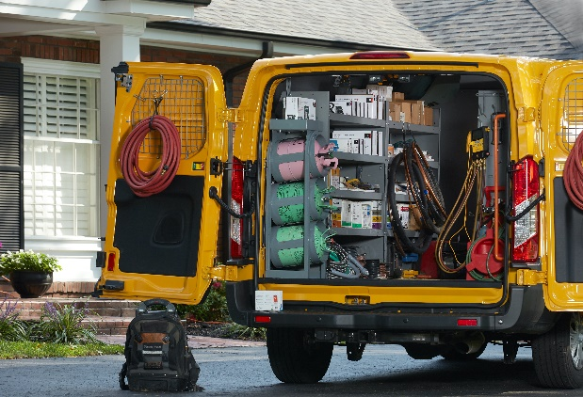
Business Case
Universal Heat Pump Defrost Control offers contractors a unique opportunity to deliver a product with direct savings to their customers. By eliminating wasteful run time from traditional time-based defrost controls, this control offers immediate savings to homeowners, and a great sell-in opportunity to technicians.
Heat Pump Market Potential
25M Units Installed Base | 2.9M Units | 250K Defrost Controls
Every Unit has a Defrost Control | Heat pump growth market* 20% in 1997 35% in 2018 | Estimated annual service market
*percentage of condensing units that are heat pumps
By upgrading to a Demand Defrost Option, homeowners reduce energy usage compared to Time/Temp Defrost Control, saving them $$$.

Slide 9
What The Pro’s Are Saying
“Very easy to install and to setup. Make my heat-pump work like a charm.”
January 20, 2016 – Denis
“Programming the settings was simple and I set it for low energy use. It’s operating beautifully.”
January 4, 2019 – U. Huren
“Excellent product if you want to save money on your heat pump that has a dumb timer based defrost. Installed this in under an hour and now have demand defrost on my two year old Goodman unit. Went from hourly defrosts of nearly no build up to a defrost every 4 hours on a dry day and about every 45 minutes during a freezing rain storm. If in doubt... Buy it!”
January 25, 2017 - S. Begin
“Extremely easy to install would buy again.”
December 13, 2018 – D. Miller

Slide 10
Technical
47D01U-843 Universal Defrost Control

Slide 11
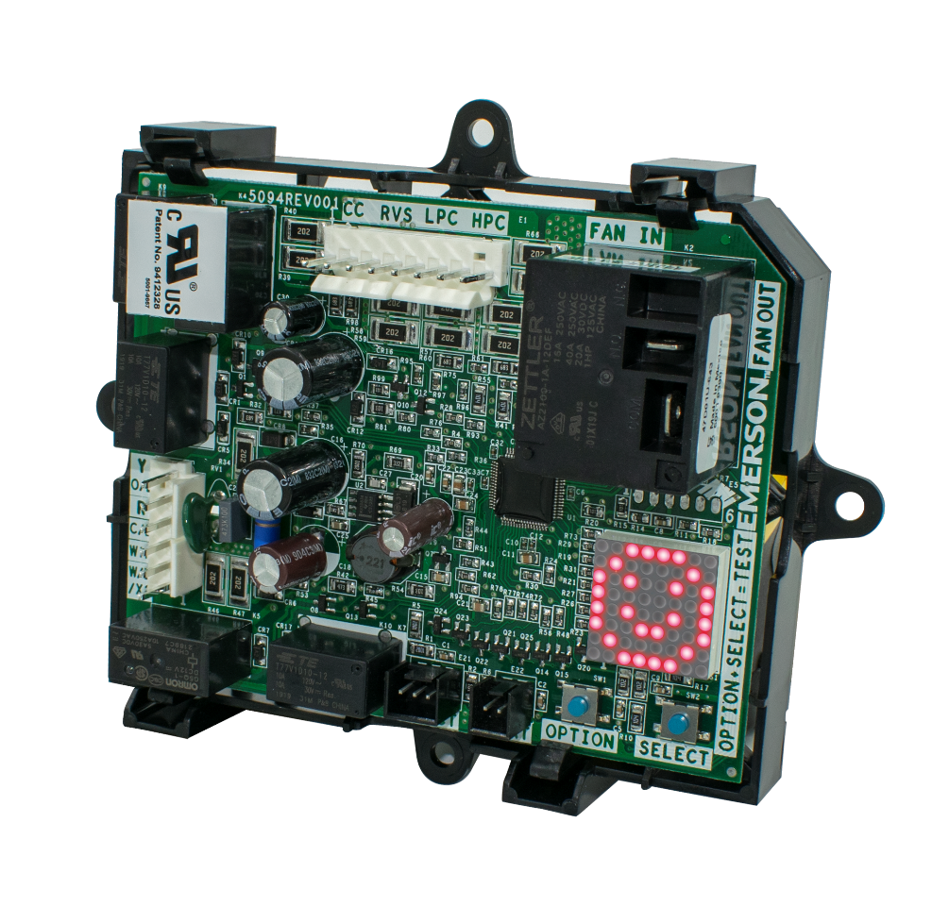
Introduction
A wide range of existing Time Defrost Controls can be replaced by the White-Rodgers 47D01U-843 Defrost Control, increasing the efficiency of existing systems by shifting system operation from time-based to demand-based.
Defrost Control | Defrost Cycle Timing
Demand Defrost Option | Demand Defrost Option Defrost cycles limited to on-time delivery, based on need*
Time Defrost Option | Defrost cycles generated on pre-set time schedule
* Demand defrost WILL run one cycle every 6 hours to ensure that oil viscosity is appropriate to return to compressor.

Slide 12
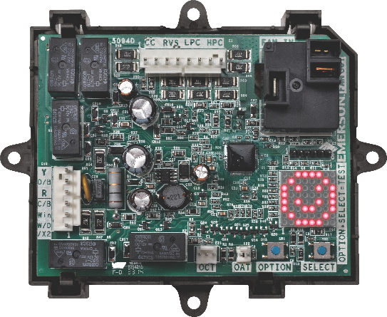
Applications
Single Stage Heat Pump Systems, PSC Condenser Motor
Selectable / Adjustable Options
With or without AUX Heat
Low Temp compressor lockout
9 compressor temp settings, for compressor shutoff
Dual fuel compatible
Selectable Brownout protection with Random Time Start Delay
Provides AUX heat lockout
With outdoor temperature sensor – included in kit
Demand Defrost
Non-adjustable 6 hour cycle to ensure that oil viscosity is appropriate to return to compressor
Time/Temp Defrost
30-120 minute adjustable cycle time*
Selectable “O” or “B” reversing valve
Reversing valve shift delay (0,12,30 seconds)
Short cycle time (0,3,5 minutes)
* Upgradable Time/Temp Defrost systems can be upgraded to Demand Defrost, resulting in greater energy efficiency

Slide 13
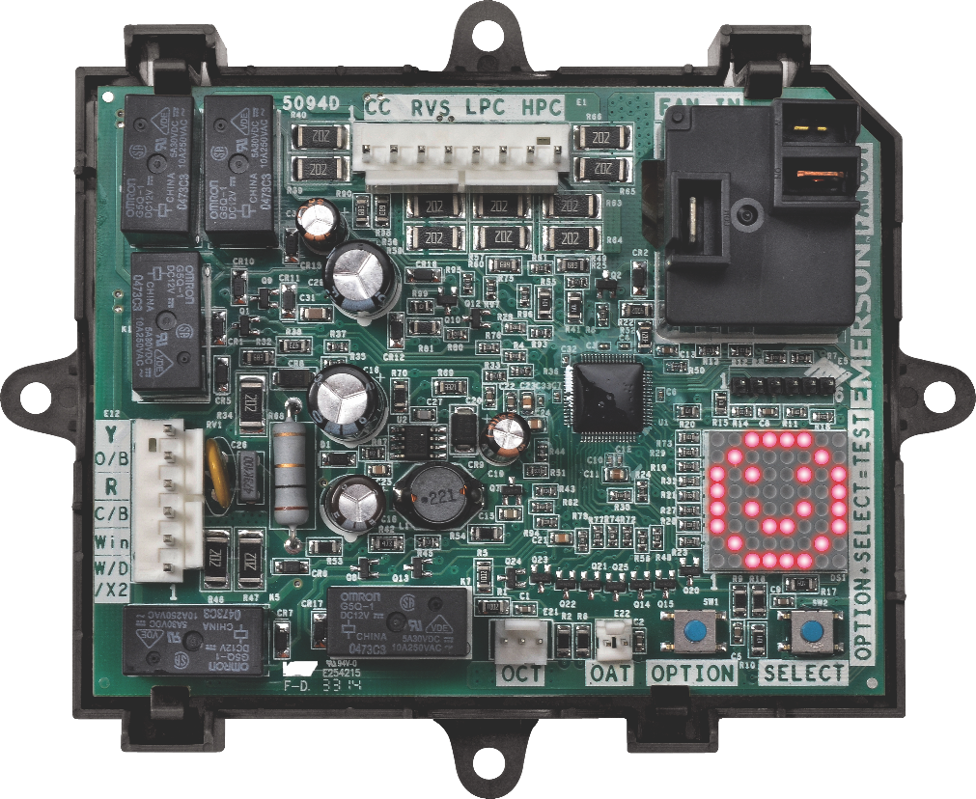
Specifications
INPUT VOLTAGES
208/240 VAC 50/60 Hz (Primary)
24 VAC 50/60 Hz (Secondary)
INPUT CURRENT OUTDOOR FAN MAX
0.5 HP @ 240 VAC Motor
0.125 @ 120 VAC Motor
10mA @ 24 VAC, ECM Motor
OPERATING RANGE
Temperature, -40°F to +150°F
Humidity, 0 to 95% Rh, non-condensing

Slide 14
Compatible with top manufacturer heat pumps
Choose from 8 pre-configured OEM Equipment Brands:
Display | OEM | Defrost Type | Defrost Cycle Time | Short Cycle Time | RV Power | RV Shift Delay | Max Defrost Time | Defrost Enable Coil Temp | Defrost Terminate Coil Temp.
 | Carrier | T/T | 90 min | 5 min | O | 0 sec | 10 min | 30° | 65°
 | Goodman | T/T | 30 min | 5 min | O | 30 sec | 10 min | 35° | 70°
 | Lennox | Demand | n/a | 5 min | O | 30 sec | 14 min | 35° | 50°
 | Trane | Demand | n/a | 0 min | O | 12 sec | 14 min | 36° | 50°
 | Rheem* | Demand | n/a | 5 min | B | 30 sec | 14 min | 35° | 70°
 | York | Demand | n/a | 5 min | O | 30 sec | 8 min | 31° | 80°
 | Nordyne | Demand | n/a | 3 min | O | 30 sec | 14 min | 35° | 70°
 | Factory Default | Demand | 30 min | 5 min | O | 30 sec | 14 min | 34° | 70°
Additional adjustments i.e. setting demand defrost or changing the defrost enable & terminate coil temp are customizable in the options portion of programming that utilizes the 8x8 LED Matrix, the “option”, and “select” buttons.

Slide 15
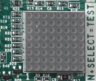
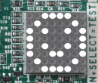
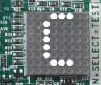
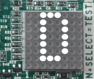
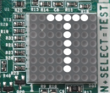
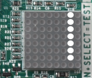
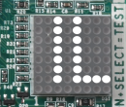
Troubleshooting
Display | Condition | Comments for Troubleshooting
 | Power Up | Normal Operation During Power up all LED’s on the 8 x 8 matrix display will light up
 | Standby | Normal operation with power and no active call
 | Running in Cooling Mode | Steady on represents an active call for cooling. Blinking represents short cycle or other time delay active with a compressor demand.
 | Running in Heating Mode | Steady on represents an active call for heating. Blinking represents short cycle or other time delay active with a compressor demand.
 | Running in Defrost Mode | Represents the control in defrost mode
 | Field Test Mode | Displayed till the OPTION+SELECT buttons are pressed Applicable to short cycle bypass as well as forced defrost field test mode
 | LPS Trip | Low Pressure switch must be connected to the Universal Heat Pump Defrost control and an option selected from the menu. If low pressure switch opens during an active call the system will shut down. Normal operation will resume after switch is closed
 | LPS Lockout | If the Low Pressure switch opens 3 times the control will lockout

Slide 16
Troubleshooting cont.
Display | Condition | Comments for Troubleshooting
 | HPS Trip | High Pressure switch must be connected to the Universal Heat Pump Defrost control and an option selected from the menu. The pressure switch is normally closed. An open condition will trigger this error. Normal operation will resume after the switch is closed.
 | HPS Lockout | If the High Pressure switch opens 3 times the control will lockout.
 | Air Sensor Fault | Outdoor Air Temperature Sensor (OAT) is at fault. Possible bad connection
 | Coil Sensor Fault | Outdoor Coil Temperature Sensor (OCT) is at fault. Possible bad connection
 | Consecutive Defrost | Two Consecutive Defrosts Terminated on Maximum Defrost Time
 | Low Control Voltage | Possible 24 VAC brownout condition
 | Control Failure | Replace Control

Slide 17
WR Mobile App
Always up-to-date and easy to use:
Mobile App
White-Rodgers Website
Your resource for:
Product information and spec sheets
Complete Cross Reference
OEM compatibility
Installation information and videos
Wiring diagrams
Download:
Go to your app store
Type in WR Mobile
Install the app
OR
Open your camera
Hold it over the QR code
Tap “Open” on the
pop-down
Install the app

Slide 18
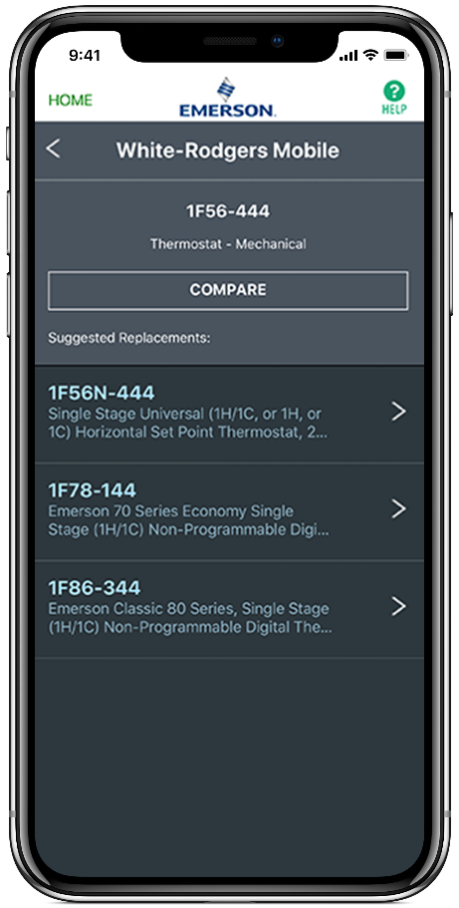
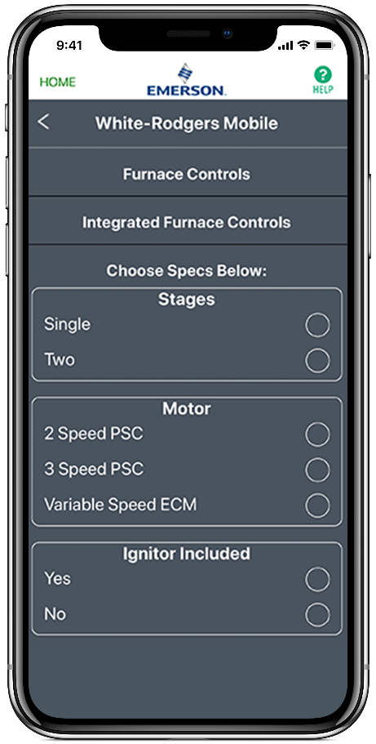
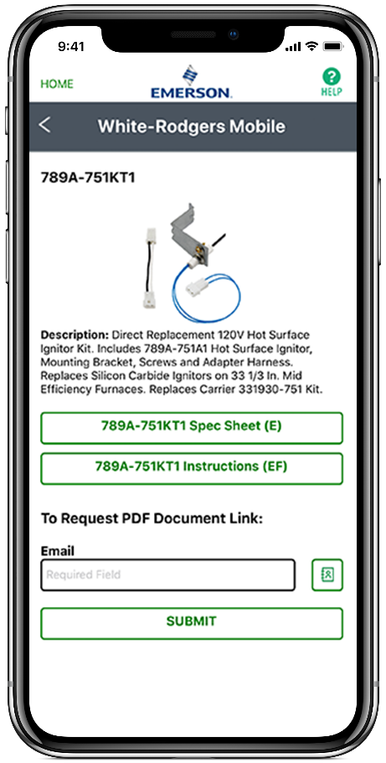
WR Mobile App
Easy to use!
Search by OEM, Competitive, or White-Rodgers Model Number
Product Number
Scrollable Product List
WR Replacement

Slide 19
White-Rodgers Cross Reference
Go to: www.whiterodgers.com
Hover over Tools & Resources
Click on: White-Rodgers Cross Reference/Product Information
Enter the Model Number or click on: Search Replacement Heating Controls by Major OEM Brand

Slide 20
Wholesale Resource Site
Access useful resources to grow your business.
Visit: https://climate.emerson.com/en-us/brands/white-rodgers/white-rodgers-wholesaler-resource-center
You’ll find videos, stocking lists and product launch information for the following product families:
Heating Controls
Cooling Controls
Sensi Smart™ Thermostats
Traditional Thermostats
Contractor Rewards
Product Merchandising

Slide 21
Why Contractors Trust White-Rodgers
Industry Leading Products
Used by more OEM’s
Offering the widest range of Universal Replacement Controls
Ease of Installation
Simple, easy to understand instructions
Product Reliability
Quality Control assures reliable products
Affordable
Competitive pricing
Supported by Knowledgeable Representatives
Contractor direct phone support

Slide 22
Install
47D01U-843 Universal Defrost Control

Slide 23
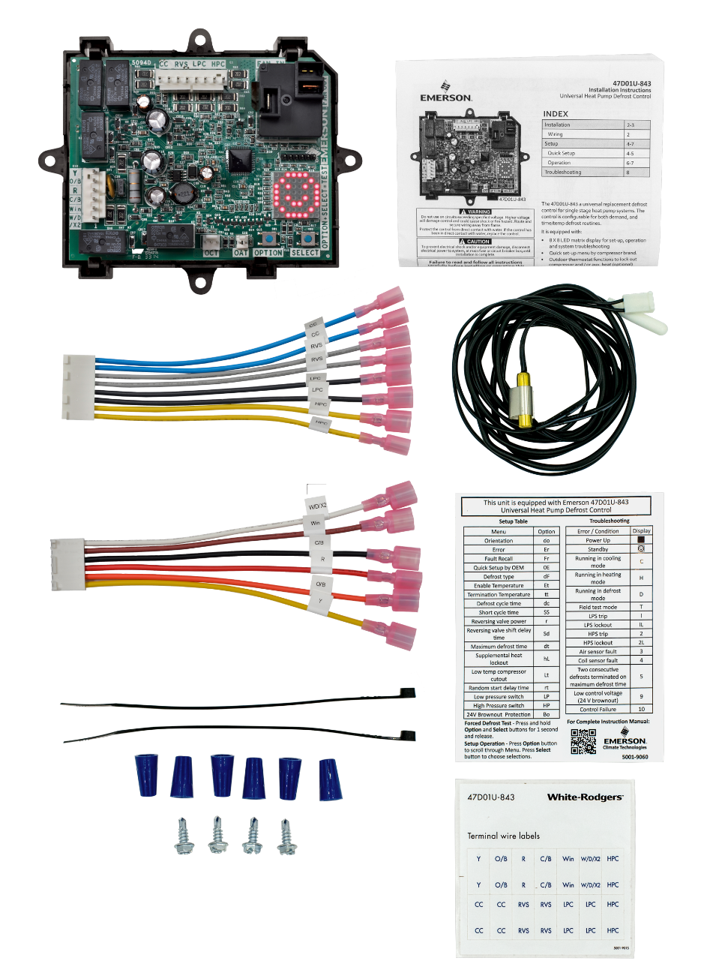
What’s In The Box?
Universal Heat Pump Defrost Control
Includes universal plastic mounting tray + 4 screws
Thermostat Harness
One harness, equipped with spades. Cut, strip, and wire nut if desired (included)
Heat Pump Harness
Connect reversing valve, contactor, low and high pressure switches
Thermistors
One to measure coil temp, and one to measure air temp
Install air temp sensor for selectable lock out settings/ for use of demand defrost
Additional
Zip Ties To manage harness locations
Terminal wire stickers to label existing wires
Setup and Troubleshooting label

Slide 24
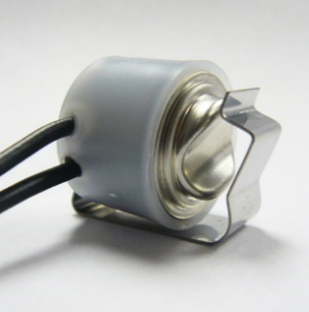
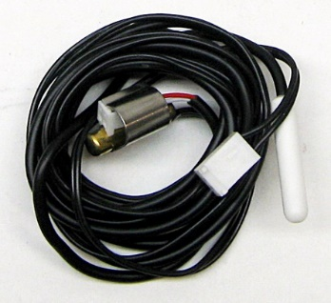
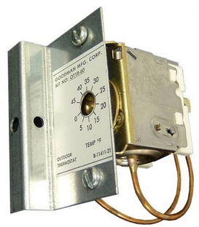
Integrated Value-added Features
Defrost Thermostat | Outdoor Heat-Pump Thermostat
The 47D01U-843 includes a new coil sensor and a new air temperature sensor. The old snap-disc coil sensor is upgraded to a thermistor type. | A built-in Outdoor Heat-Pump T/stat feature allows for Auxiliary Heat and Compressor Lock-outs. States like CA and NC are requiring this control to keep Electric back-up from coming on when it’s over 40°F outside.
✓
✓

Slide 25
Instructions

Slide 26
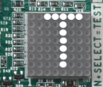
Quick Set Up Configuration with Matrix LED
Simple Start-up Walk-through steps
Normal Status With Thermostat off, power up the system. The LED will light all segments and then show the standby smile
Select the Display Orientation Press the OPTION button until you see “do” which stands for “Display Orientation”
Adjust Orientation Press SELECT until the “Hi” characters are in the correct readable position. They move in 90° increments
Choose OEM Configuration Press the OPTION button 3 more times or until Original Equipment (OE) is displayed
Choose Pre-Configured OEM Settings Press SELECT until the correct OEM default number (1 through 8) appears (Reference to the OEM Quick Setup Options)
Press OPTION to confirm setting
Test Defrost Press and hold OPTION and SELECT at the same time for 1 second to initiate a test defrost cycle with forced defrost
Press Option (repeatedly) or wait 30 seconds for the standby smile to appear.

Slide 27
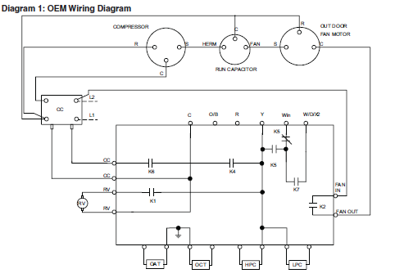
Installation & Wiring
Refer to equipment manufacturer’s instructions for specific system wiring information. Wiring tables shown are for typical systems and describe the standard functions.
Disconnect power to unit
Label wires & take a picture of the current installation
Remove existing control & remove wires
Install replacement control secure with provided mounting screws in desired location
Connect labeled thermostat wires to Thermostat Harness, then connect harness wires to the control
Connect remaining labeled system wires to Heat Pump Harness (#2) and connect harness wires to the control
Connect outdoor coil temperature sensor to the control
Connect outdoor air temperature sensor to the control
Connect high & low pressure switches to the control
5
6
7
Verify harness connection
8
9
Please note:
Air sensor should not touch unit cabinet.
Coil sensor needs solid locating, e.g. place where original snap disc was located

Slide 28
Learn to install the 47D01U-843 Universal Defrost Control

Slide 29
Tech Tip: High Pressure and Low Pressure Monitoring and Fault Codes

Slide 30
Outdoor (OAT) and Coil (OCT) Sensor

Slide 31
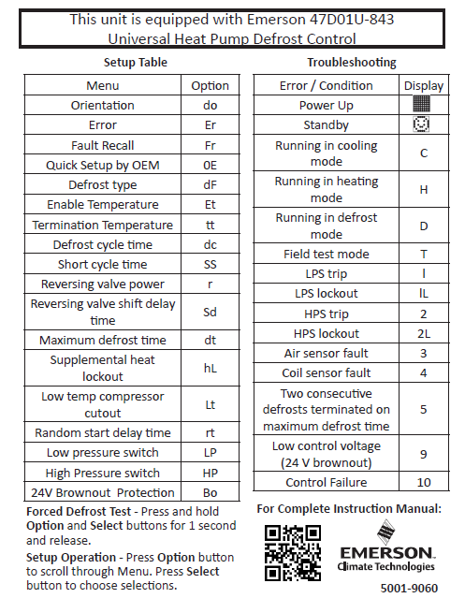
Troubleshooting
White-Rodgers provides a Set-up & Troubleshooting sticker to place inside the unit for quick reference:
Status Indicator
Power up or stand by
Heating / cooling / defrosting
Test mode
Provides a 30sec quick test to verify proper operation
Troubleshooting
Fault conditions present
Highest priority and operating condition toggling
Remaining errors “ER” menu
Correct condition to remove errors
Recall Historical Data
Recall up to last four faults

Slide 32
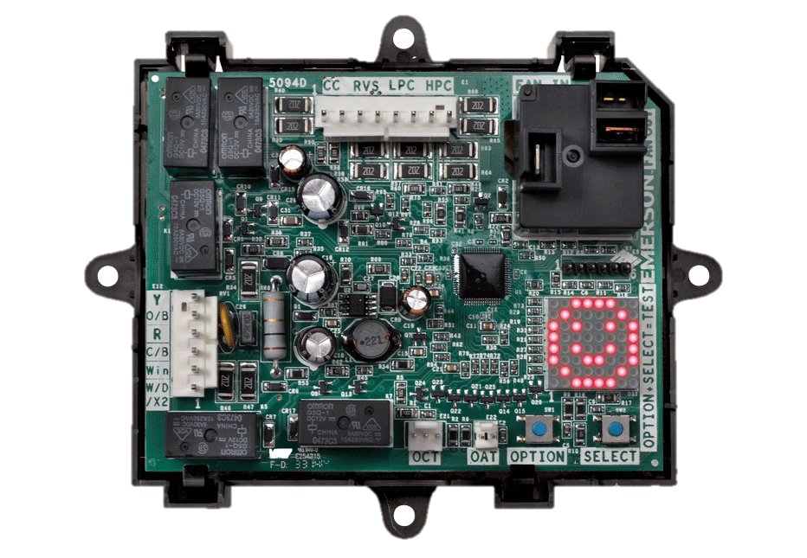
Thank you
47D01U-843 Universal Defrost Control
R-5057-2

